Slide 2
Northern oil & gas

Slide 3
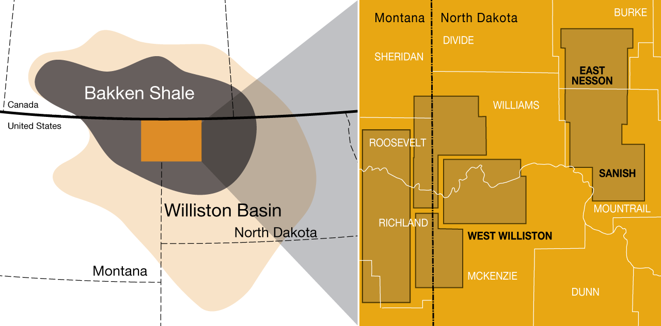
Oasis Petroleum
This is a very clean and easy to understand concept. Would be good to replicate with PSH’s land base added to the map on the right. Provides clear indication of land base, counties, etc.

Slide 4
Oasis Petroleum

Slide 5
“Layered map” idea – Can start with a land base, then layer on additional land / locations / activities, as they occur.

Slide 6
Exposure to the best operators in the best oil play –
Choose to participate with the best operators and be selective about areas of focus
Down spacing and lower Three Forks benches may add significant drilling inventory
Purchase at Discount to Market = Low Entry Cost Enhances Returns
Constant access to deal flow with Smaller Parties With Funding Difficulties

